Slide 1

Distinguish Sound With Machine Learning.
Urban Sound
Classification

Slide 2
OVERVIEW
Background: exposed to different sounds every day
Goal: to classify sounds automatically
Challenge: compared to image, feature extraction for sound is not quite straightforward

Slide 3
OUR PROCESS FOLLOWS:
Data Exploration
Model Training
Results Comparison
Feature Extraction

Slide 4
Data
Source: Urban Sound Dataset
Size: 1302 labeled sound recordings
Format: each recording is a wav file
Content: 10 classes of sounds ( air_conditioner, car_horn, children_playing, dog_bark, drilling, enginge_idling, gun_shot, jackhammer, siren, and street_music )
Usage: 30% of the data is regarded as test data

Slide 5
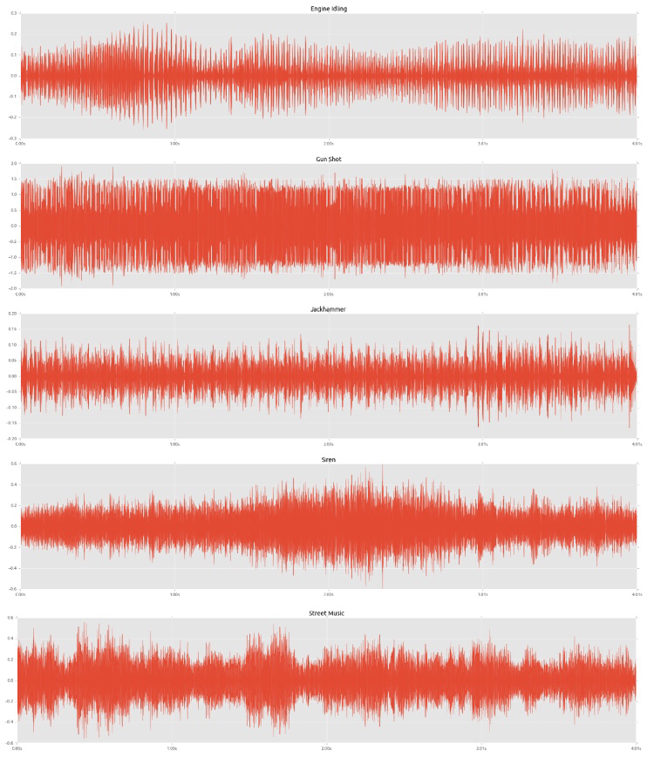
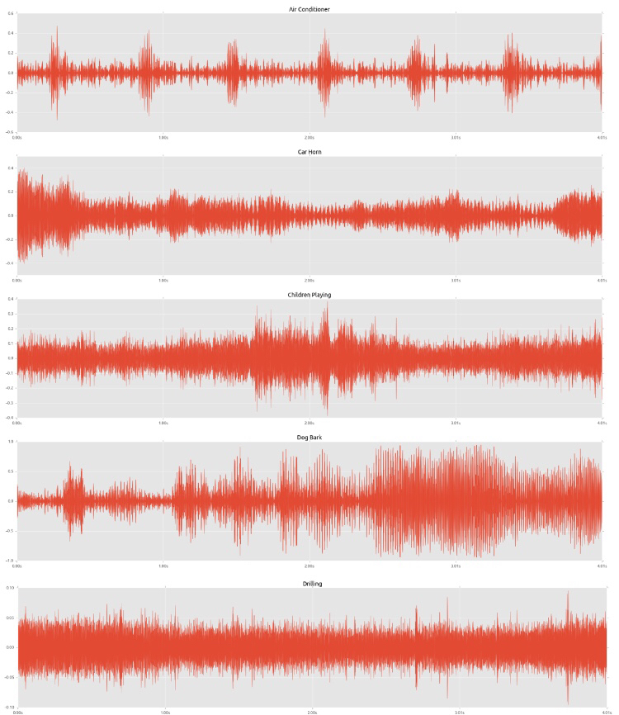
Waveplot

Slide 6
Feature Extraction
Tool: Librosa library in Python
Methods:
melspectro gram: Compute a Mel-scaled power
mfcc: Mel-frequency cepstral coefficients
chorma-stft: chromagram from a waveform/power spectrogram
spectral_contrast: Compute spectral contrast, using method
tonnetz: Computes the tonal centroid features (tonnetz)
Output: Matrix of 1102 rows, 193 columns

Slide 7
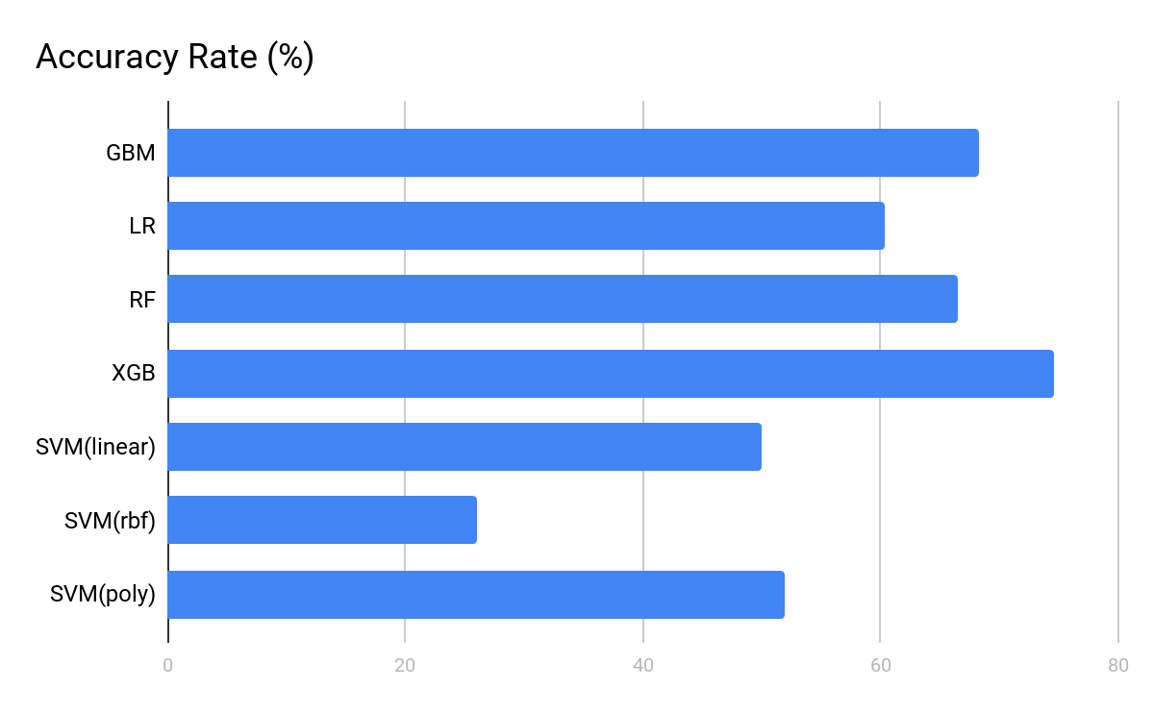
Model Comparison
Accuracy Rate:

Slide 8
Model Comparison
Accuracy for Each Class:

Slide 9
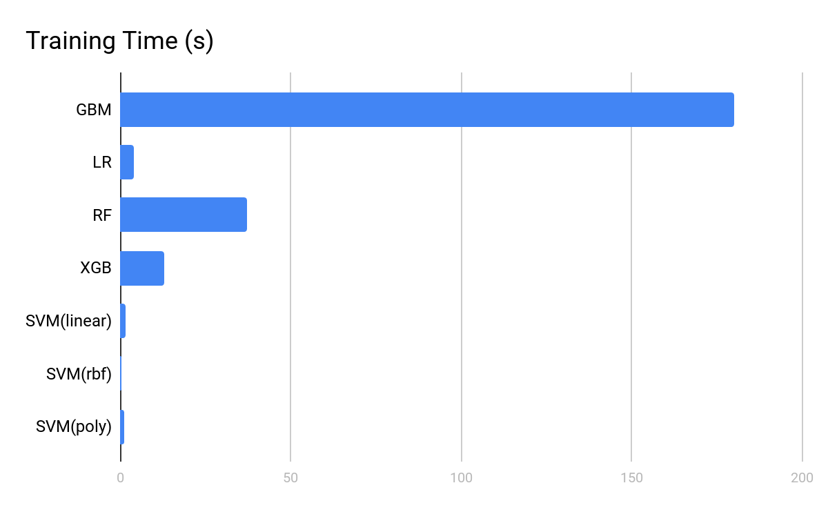
Model Comparison
Length of
Training Time:

Slide 10
Model Comparison
Model | Accuracy Rate (%) | Training Time(s)
GBM | 68.28 | 1200
LR | 60.42 | 3.96
RF | 66.47 | 37.09
XGB | 74.61 | 13
SVM (linear) | 50 | 1.62
SVM (rbf) | 26 | 0.43
SVM (poly) | 52 | 1

Slide 11
Improvements
Use a larger dataset on the official website which contains more than 8000 audio records with these 10 different classes. Intuitively, more data available, more accurate for model performs.
Set up a more complex CNN with at least 10 layers, and with some other techniques, such as adding zero-padding or dropout layer to classify those audios.
Try to use different combinations within those five kinds of features we extracted. We have assumed that perhaps some kinds of the features are much more outstanding than others. So why not try to ignore those "unuseful" features, at some points, reduce dimensions, and train the model on the subset of the features. The result could be exciting, or not.
Try to extract other kinds of features.

Slide 12
THANKS
Any questions?
You can find our projects at
https://github.com/TZstatsADS/fall2017-project5-grp4

